Slide 1
Similarities in Mental Distress and Spiritual Crisis
Manresa Link Spring Conference Workshop
13 March 2021
Nuala Graham

Slide 2
A bit about me . .
Employee of Birmingham Social Services for 35 years
Worked in Child Protection, Mental Health, Supervision, Research
Prayer Guide with Manresa Link for many years

Slide 3
Phd Research
Explores Similarities in Mental Distress and Spiritual Crisis
6 research participants shared their experience of
Mental Distress
Spiritual Crisis
Intervention they chose
Outcome of the interventions

Slide 4
Mental Distress Definition
Lowering of Mood
Reduction of Energy
Decrease in Activity and Capacity for Enjoyment
Interest and Concentration are reduced
Sleep is Disturbed
Appetite diminished
Self Esteem and Confidence is almost always reduced
Some ideas of guilt and worthlessness are often present
Source: International Classification of Diseases Manual

Slide 5
Spiritual Crisis Definition
Self described by individuals
Informed by writings of St Ignatius who located where Spiritual Crisis may be in his suggestion that we hold in balance three dimensions of the Church:
Our Relationship with God
The Church as an organic Institution possessing authority in doctrine and discipline
Church as a human society subject, like any other human society to challenge and threat outside and to inner tensions, ambivalence and sinfulness.

Slide 6
Similarities in Mental Distress and Spiritual Crisis
Similarities
Differences
5 out of 6 experienced Physical and Psychological distress
Presence of unrealistic expectations beyond their capacity
Source of unrealistic expectations
Mental Distress Group: family
Spiritual Crisis group: relationship
with God and the Institutional
Church.

Slide 7
Narratives, Interventions & Outcomes for
Mental Distress

Slide 8
Participant 1 Mental Distress
Source of Distress: Expectations of Family beyond her capacity
Intervention chosen: Pastoral Care. Parish Priest - available, attentive understanding. Offered her time and support she needed.
Outcome: A Slow return to normal feeling levels. Significance of sound and music in her recovery.

Slide 9
Participant 2 Mental Distress
Source of Distress: Parental bereavement in childhood - remaining with her like silent frozen pain.
‘Give sorrow words, grief that does not speak, whispers the overfraught heart and bids it break’ (Macbeth)
Chosen Intervention: Counselling
Outcome: new freedom to feel in a healthy way, the sorrow and joy in that relationship

Slide 10
Participant 3 Mental Distress
Source of Distress: Birth of her baby - Difficult delivery – family and community expectations for a quick recovery.
Intervention made on her behalf: hospital admission for a short period. Recovery came from her inner resources . . . Process of transformation from caterpillar to butterfly…. HOPE sustained her.
Outcome: experience of Freedom at a Feeling Level
A gradual process for all three participants

Slide 11
A few moments for reflection and adding questions or comments in the chatbox.

Slide 12
Narratives, Interventions & Outcomes for
Spiritual Crisis

Slide 13
Participant 1 Spiritual Crisis
Source of Crisis: Vocation in Ministry
Intervention chosen: Counselling
Outcome: Ability to make changes in her life peacefully.
Enabled to enter the unknown, and trust in God’s
love and protection.

Slide 14
Participant 2 Spiritual Crisis
Source of Crisis: Issue of Conscience and Conflict with authority and teaching of the Church - in the areas of sexuality, traditional family life, gender prescribed roles within the Church.
(however she did not experience psychological nor physical distress)
Intervention Chosen: Friendship
Outcome: a maturing process, being at peace with her conscience and with God. Arriving at a new place of taking responsibility for herself.

Slide 15
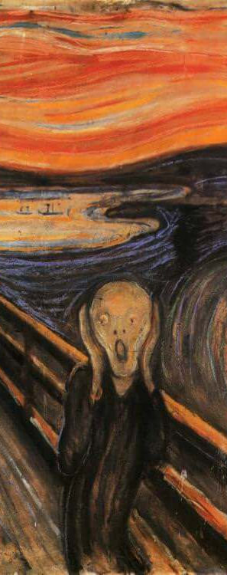
Participant 3 Spiritual Crisis
Source of Crisis:
Childhood script of ‘Yes’ to the needs of others and ‘No’ to self
reinforced by her Church community.
Led to Anger, resentment and distaste for anything spiritual.
Intervention Chosen: Counselling ( 1 session) focused on
her basic right to have space, privacy and boundaries
a cognitive change of behaviour. Challenge to shift from a resentful ‘yes’ to a peaceful ‘no’.
Outcome: Relief, an experience of freedom from an unbearable burden. Creative space

Slide 16
Outcomes for Participants experiencing Spiritual Crisis
Freedom to make changes in their lives.
For two participants there were identifiable moments - an ‘epiphany’.
For the third, it was a slow process, leading to interior changes.

Slide 17
Conclusion
Whatever resource an individual chooses is the right one for them
It is the responsibility of the resource provider to stay with the integrity of the discourse and discipline
Spiritual resources are relevant for mental health
Counselling is relevant for spiritual crisis
The value of friendship needs to be brought to the forefront
The individual’s inner resources must never be underestimated.

Slide 18
Individual Time of reflection
Make note of any reflections, questions or comments.
Add them to the chat box if you wish
Coffee Break until 11.30am
Questions for small groups will be displayed during the break.

Slide 19
Back for 11.30am Questions for Small Groups
Group 1 and 2
1a What experiences have you had in becoming aware of and containing, physical and psychological distress in prayer guiding?
1b What might some of the challenges be for you as a prayer guide?
Groups 3 and 4
2. How might holding awareness of the three dimensions of the Church be helpful in prayer guiding?
Groups 5 and 6
3. Discuss the power of creative and destructive expectations

Slide 20
In small groups for 25 mins
Take note of your break out group number as you click the invite button
Appoint one person from your group to feed back a key point from your discussion in the plenary session.
Discuss the question allocated to your group number ( if you have time choose another question to discuss)

Slide 21
PLENARY SESSION
Feedback on questions from small group discussions
Responses to some of the questions in chat box

Slide 22
A Parting Thought . . . .
Maintaining the
Sacred Space
in
Spiritual Accompanying

Slide 23
References
Gerard O Mahony SJ (2000) Finding the Still Point, Making use of Moods, Surrey: Eagle.
International Classification of Diseases (F32, p 314)
M. Ivens SJ ( 2008) Understanding the Spiritual Exercises page 248
Nuala Graham email: nualabawn@gmail.com
Nuala’s thesis is available at Manchester University via the following link. (You will be required to register to gain access to the thesis)
https://ethos.bl.uk/OrderDetails.do?uin=uk.bl.ethos.496697

